Slide 1
MP4: Big Core Energy
By: - FISH - Tongyu Liu(tongyul3) and Benjamin Kalnbach(bak7)

Slide 2
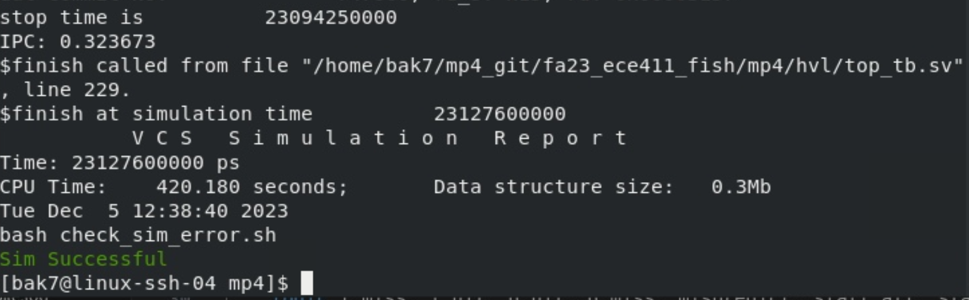
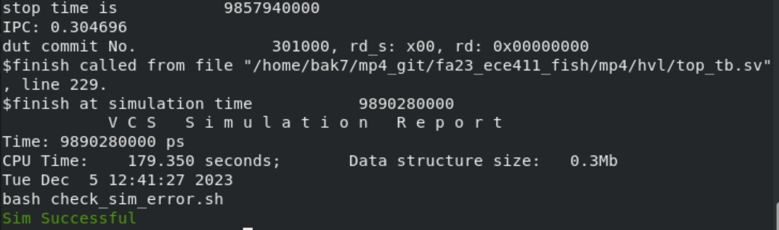
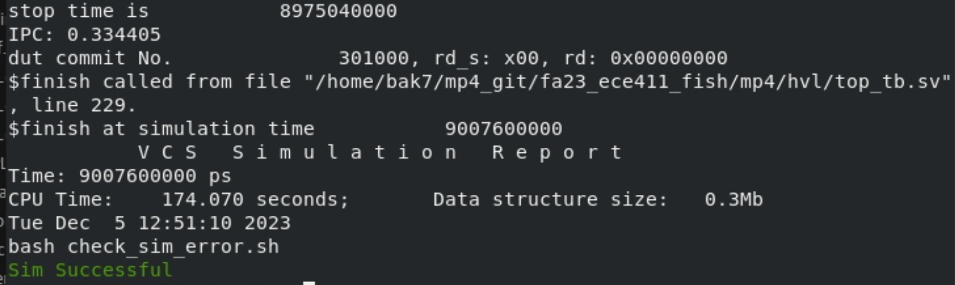
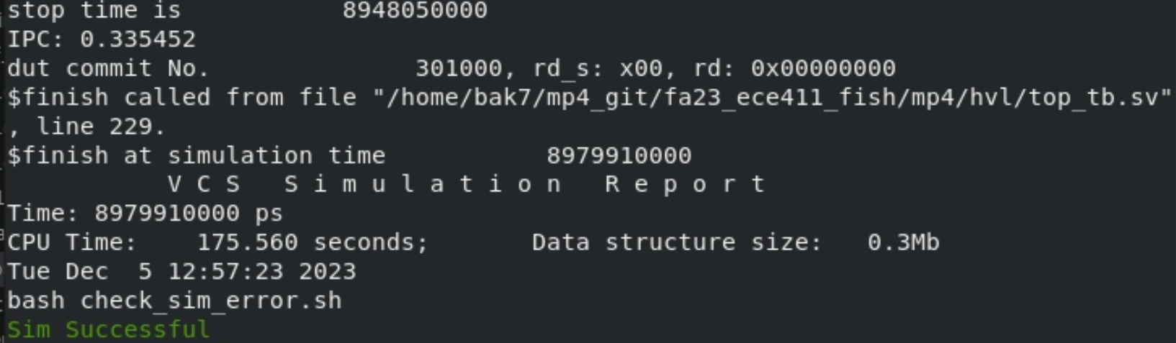
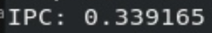
Performance Progression
Base level Core:
With Multiplication and Division:
With Multi/DIv and BTB:
With Multi/Div, BTB and Prefetcher:

Slide 3
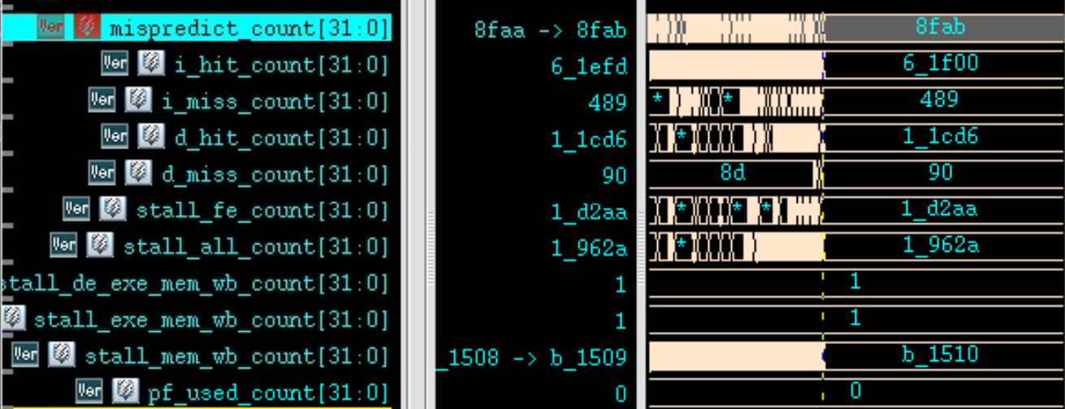
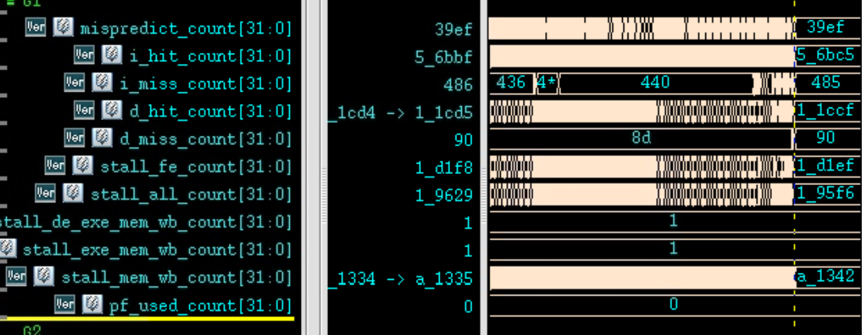
BTB: Branch Table Buffer
-FIFO to store the branch targets/history, prediction based on history
-52 fewer all stage stalls
-2875 fewer fe_de stalls
-4 fewer i_cache misses, but 45883 fewer hits
-21948 fewer flushes
-65998 fewer mem_wb stalls

Slide 4
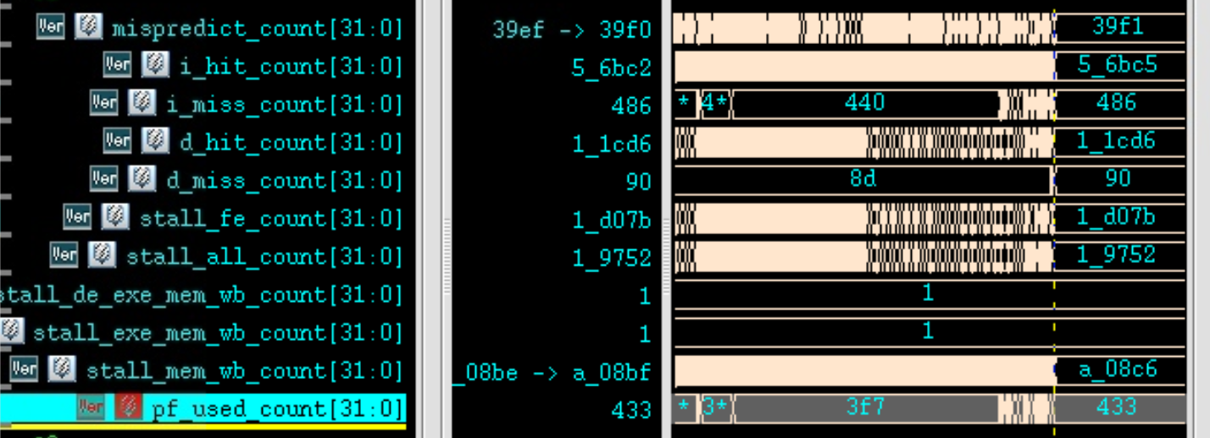
Prefetcher: Next Line Prefetch Buffer
-Fetching from pmem the cacheline next to the one contains pc_wdata
-Many usages: icache saved lots (1075) of pmem requests by getting the instruction from it, throughout the test run.

Slide 5
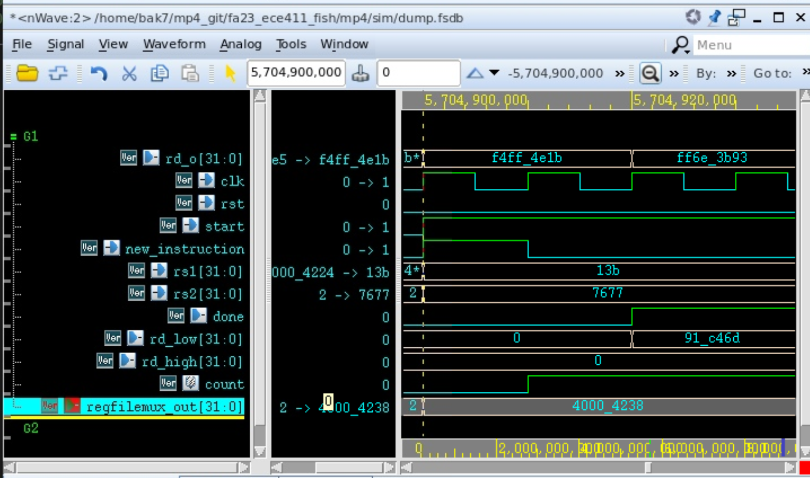
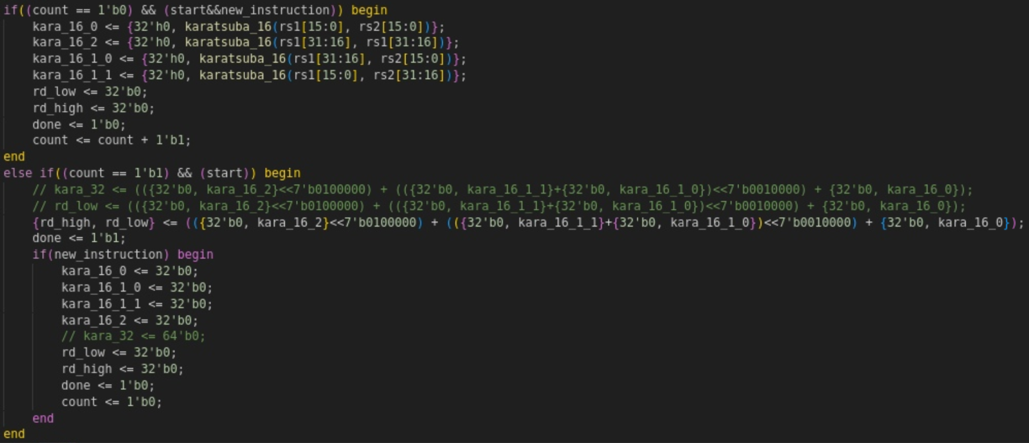
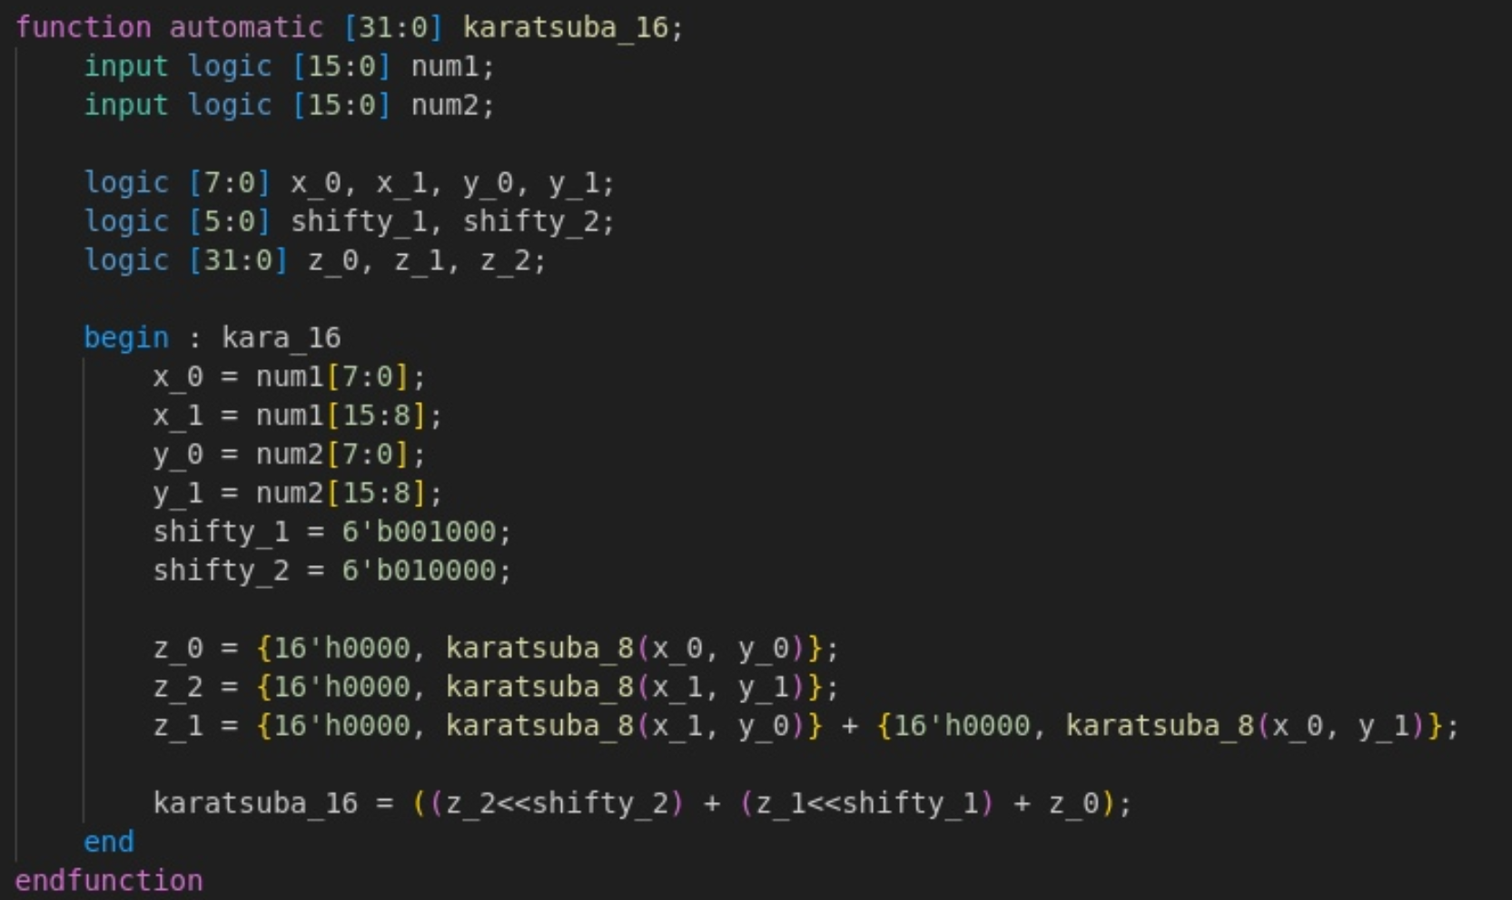
Multiplication and division
Three Cycle Karatsuba Multiplier:

Slide 6

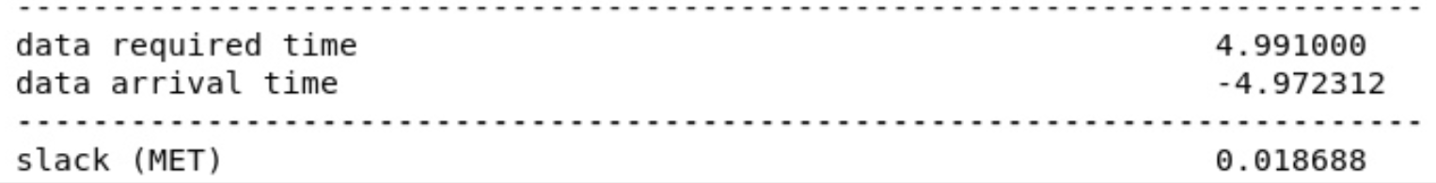
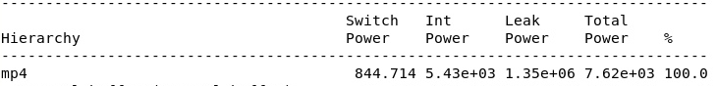
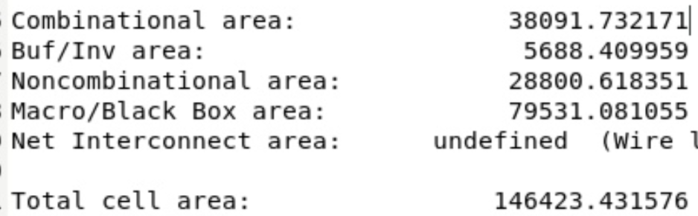
Timing, Power, and… Area
Timing: 10000ps Cycle time and Slack Met
Power:
Area:

Slide 7
Challenges
-Fixing the commit orders: sorting out the design with correct commits.
-Fixing the cache functions from MP3… (none of us had a fully working design \:( )
-At some point there were *casualties* in the group… we remember Ethan…
they just ceased working before cp2 dues and never showed up since

Slide 8
What could we have done differently?
-Start refactoring the SRAMS/caches earlier to meet the area…
-Smaller control words, more elegant/integrated control unit/pipeline designs…

